Slide 1
Hidden Markov models
Santosh GSK
Industry Expert

Slide 2
Partial Observability
Agents in partially observable environment should keep a track of current state to the extent allowed by sensors
E.g., Robot moving in a new maze
Agent maintains a belief state representing the current possible world states
Transition Model: Using belief state and transition model, the agent can how the world might evolve in next time step
Sensor Model: With the observed percepts and sensor model, the agent can update the belief state

Slide 3
Degree of belief
Earlier, the states were captured as
Facts in Logic which can take either True/False
To capture the degree of belief we will use Probability Theory
We model the change in world using a variable for each aspect of state and at each point in time
Transition models – describe the probability distribution of variables at time t, given the state of the world at past times
Sensor models – describe the probability of each percept at time t, given the current state of the world

Slide 4
Time and Uncertainty
Static World: Each random variable would have a single fixed value
E.g., Diagnosing a broken car
Dynamic World: The state information keeps changing with time
E.g., treating a diabetic patient, tracking the location of robot, tracking economic activity of a nation
Agenda of this talk: Modeling such Dynamic Worlds

Slide 5
States and Observations
Time slices: World is observed in time slices. Each slice has a set of random variables, some observable and some not.
Assumption: We will assume same subset of random variables are observable in each time slice
Denoted by E_{t} – set of observable random variables at time t
X_{t} – set of unobserved random variables at time t

Slide 6
Example
A security guard at a secret underground station
He couldn’t access the outside world so has no idea of weather
He wants to know whether it is raining
Only observed variable: His director coming in with/without an umbrella
For each day t, E_{t} - single evidence variable Umbrella_{t} (U_{t}) (Yes/No)
X_{t} – single state variable Rain_{t} (R_{t}) (Yes/No)

Slide 7
Example
There can be problems with larger sets of variables
In predicting diabetes,
Evidence Variables – MeasuredBloodSugar_{t}, PulseRate_{t}
State Variables – BloodSugar_{t}, StomachContents_{t}
Suitable time interval – one hour

Slide 8
Formulation
Assumption: The time interval between slices is fixed
Also, state variables start at t = 0
Evidence variables start at t = 1
Umbrella world can be represented by
State variables – R₀, R₁, R₂, R₃, …
Evidence variables – U₁, U₂, U₃, …
Notation: Time slice a:b → X_{a:b} → X_{a} to X_{b}

Slide 9
Transition and Markov models
Transition Model: Probability distribution over latent (hidden) state variables given the previous values, P(X_{t} | X_{0:t-1})
X_{0:t-1} – unbounded in size as t increases
Markov Assumption: Current state depends only on finite fixed number of previous states
Markov Process/Chain – Processes satisfying this assumption

Slide 10
First Order Markov Process
When the current state depends only on the previous state but not on earlier states
P(X_{t} | X_{0:t-1}) = P(X_{t} | X_{t-1})
Transition Model: P(X_{t} | X_{t-1})
Second-order Markov Process: P(X_{t} | X_{0:t-1}) = P(X_{t} | X_{t-2}, X_{t-1})

Slide 11
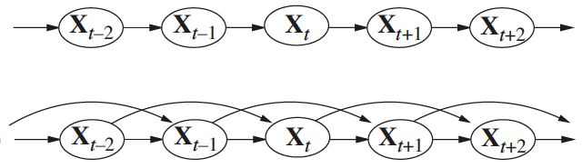
Bayesian Network

Slide 12
Stationary Process
Given the infinite values of t, the probability distribution governing P(X_{t} | X_{t-1})
Assumption: Changes in the world states are caused by a stationary process – a process of change that are governed by laws that do not themselves change over time
Therefore, P(R_{t} | R_{t-1}) is same for all t
One conditional probability table
R_{t-1} | P(R_{t}|R_{t-1})
True | 0.7
False | 0.3

Slide 13
Sensor Model
Evidence Variable E_{t} can depend on previous variables as well as current state variables, i.e., P(E_{t}| X_{0:t}, E_{0:t-1})
Sensor Markov Assumption: P(E_{t}| X_{0:t}, E_{0:t-1}) = P(E_{t} | X_{t})
Sensor Model: P(E_{t} | X_{t})

Slide 14
Bayesian Net for Umbrella Example
Rain_{t-2}
Rain_{t-1}
Rain_{t}
Umbrella_{t-2}
Umbrella_{t-1}
Umbrella_{t}

Slide 15
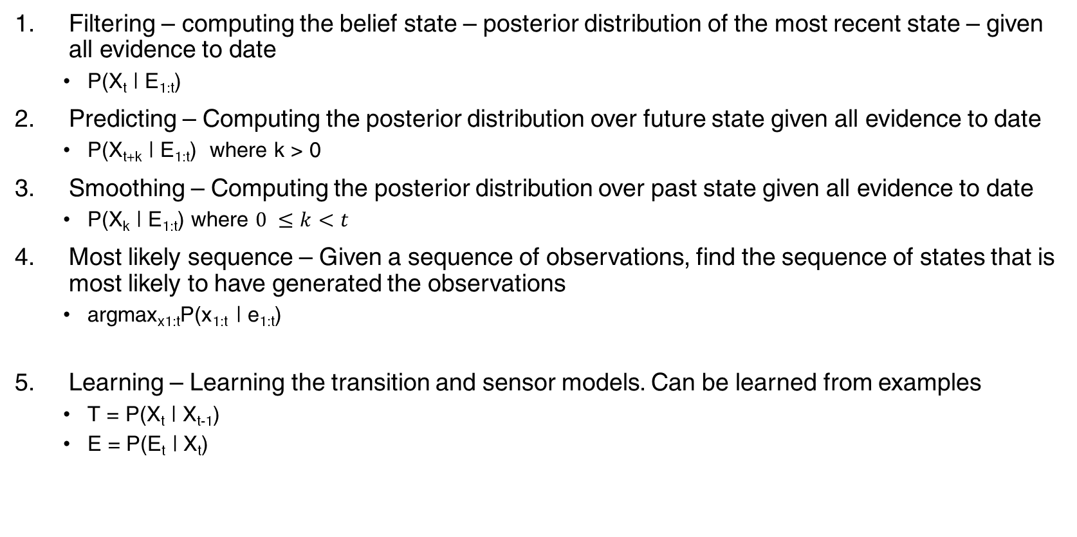
Inference in Temporal Models
Filtering – computing the belief state – posterior distribution of the most recent state – given all evidence to date
P(X_{t} | E_{1:t})
Predicting – Computing the posterior distribution over future state given all evidence to date
P(X_{t+k} | E_{1:t}) where k > 0
Smoothing – Computing the posterior distribution over past state given all evidence to date
P(X_{k} | E_{1:t}) where $0 ≤k<t$
Most likely sequence – Given a sequence of observations, find the sequence of states that is most likely to have generated the observations
argmax_{x1:t}P(x_{1:t} | e_{1:t})
Learning – Learning the transition and sensor models. Can be learned from examples
T = P(X_{t} | X_{t-1})
E = P(E_{t} | X_{t})

Slide 16
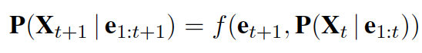
Inference - Filtering
Recursive Elimination

Slide 17
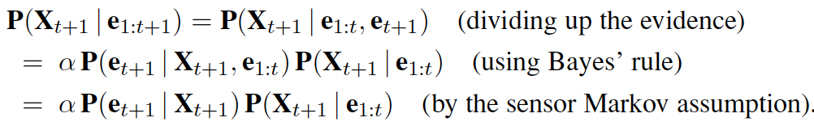
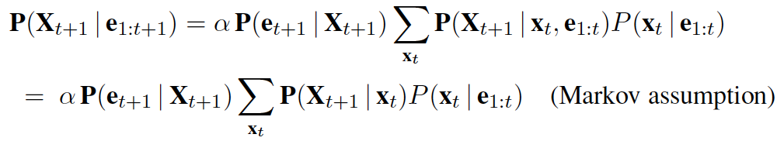
Inference - Filtering

Slide 18
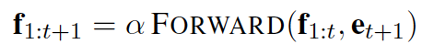
Inference – Filtering
Forward Message → f_{1:t} = P(X_{t} | e_{1:t})

Slide 19
Filtering Example
Compute P(R₂ | u_{1:2})
Transition Model = P(R_{t} | R_{t-1})
Sensor Model = P(E_{t}| X_{t})
R_{t-1} | P(R_{t}|R_{t-1})
True | 0.7
False | 0.3
R_{t} | P(E_{t}|R_{t})
True | 0.9
False | 0.2

Slide 20
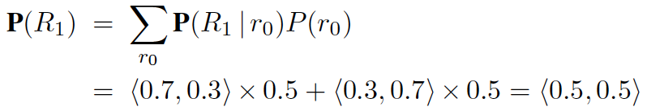
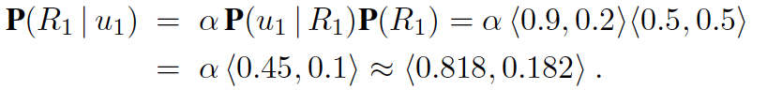
Filtering Example
Day 0: No observations, only the prior beliefs of security guard
P(R₀) = <0.5, 0.5>
Day 1: Umbrella appears U₁ = True
Adding the evidence U₁

Slide 21
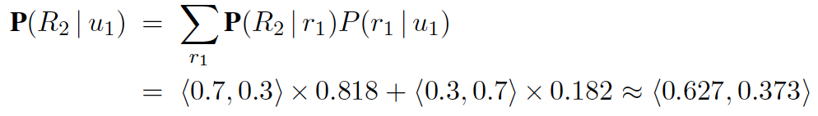
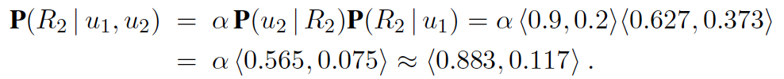
Filtering Example
Day 2: the umbrella appears U₂ = True
Then adding the evidence U₂

Slide 22
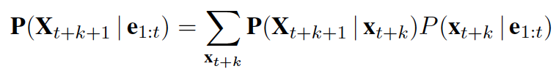
Inference: Prediction
Prediction can be seen as filtering without the addition of new evidence

Slide 23
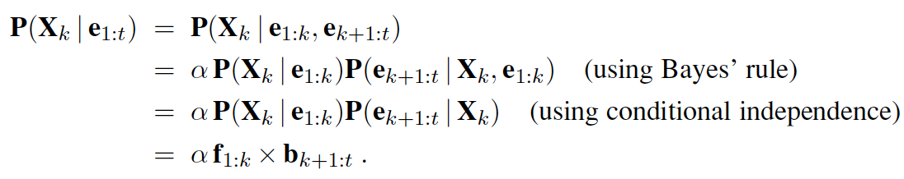
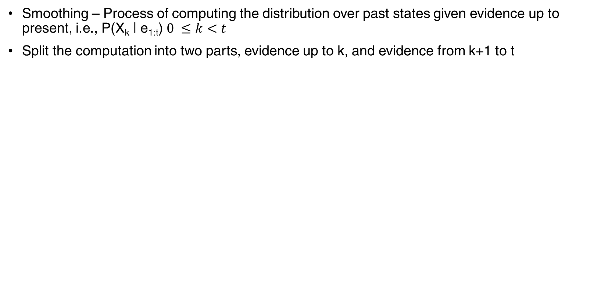
Inference: Smoothing
Smoothing – Process of computing the distribution over past states given evidence up to present, i.e., P(X_{k} | e_{1:t}) $0 ≤k<t$
Split the computation into two parts, evidence up to k, and evidence from k+1 to t

Slide 24
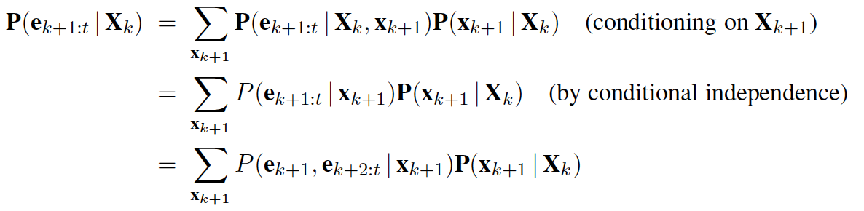
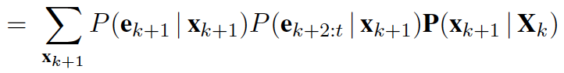
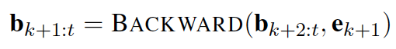
Inference Smoothing
Backward Message → b_{k+1:t} = P(e_{k+1:t} | X_{k})

Slide 25
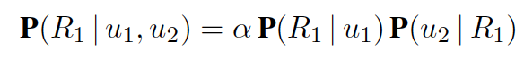
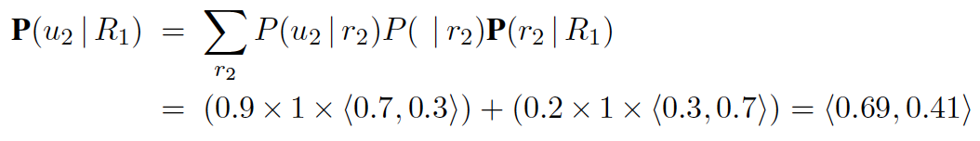
Smoothing Example
Compute P(R₁ | u_{1:2})
We already know P(R₁ | u₁) = <0.818, .182>
Plugging it back in

Slide 26
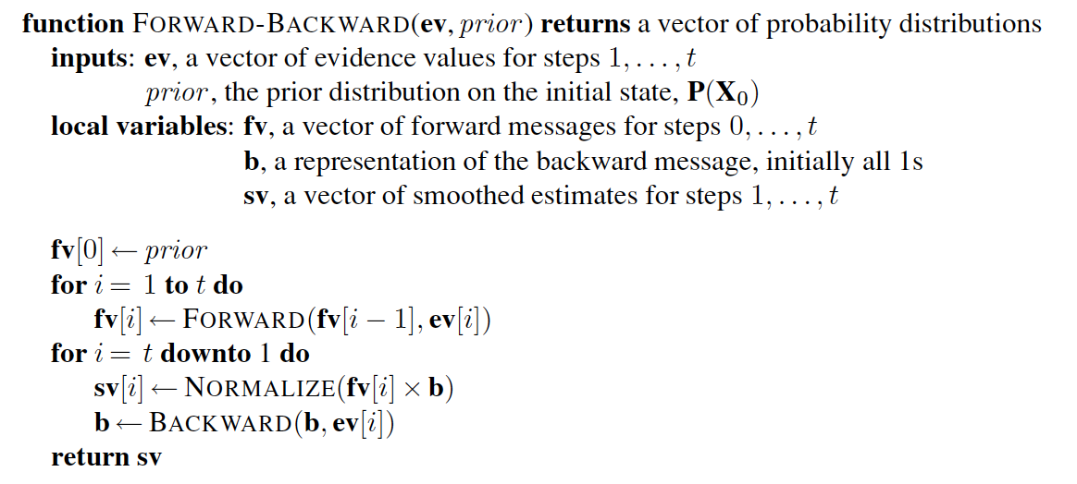
Forward Backward Algorithm

Slide 27
Most Likely Sequence
Suppose the umbrella sequence is [true, true, false, true, true]
What is the likely weather sequence that can explain this?
2⁵ possible sequences
In NLP
The Observed sequence are the words in a sentence: [Ram, killed, Ravan]
The hidden sequence are the POS tags [NNP, VBD, NNP]

Slide 28
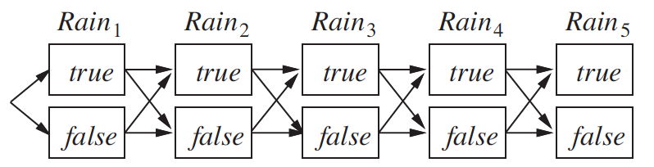
Most Likely Sequence
Algorithm
Linear Time
View each sequence as a path through a graph whose nodes are possible states at each step
Finding the most likely path – Product of transition probabilities along the path and the probabilities of given observations at each state

Slide 29
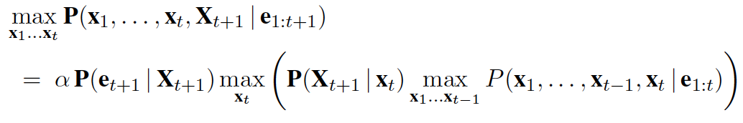
Most Likely Sequence
Algorithm
The most likely path to say Rain₅ = True consists of most likely path to some state at time 4 followed by transition to Rain₅ = True
Recursive relation

Slide 30
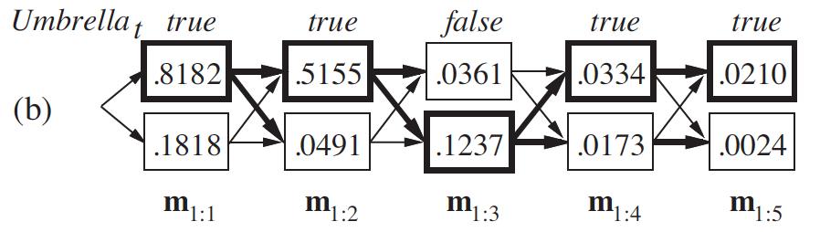
Most Likely Sequence
In order to find the actual sequence, the algorithm need to record, for each state, the best state that leads to it; indicated by bold arrows
The optimal sequence is identified by following bold arrows backwards from the best final state
This is called Viterbi algorithm

Slide 31
Hidden Markov Models
HMM – Temporal Probabilistic model in which the state of the process is described by single discrete random variable
The possible values of the variable are the possible states
Umbrella example is a HMM (Rain is single discrete random variable)
The restricted nature of HMM allows for a simple and elegant matrix implementation of the inference algorithms

Slide 32
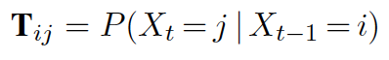
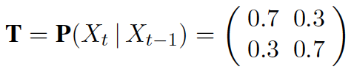
HMM: Matrix notation
Transition probabilities are expressed in a SxS matrix T where there are S possible state values and T_{ij} is the transition probability from state i to state j
For the umbrella world

Slide 33
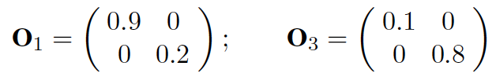
HMM: Matrix Notation
Sensor Model – As we know the values of evidence variable E_{t} at a time t, we need only specify how likely for each state to cause e_{t}
O_{t} is a SxS diagonal matrix whose i^{th} diagonal entry is P(e_{t} | X_{t} = i) and other entries are 0
On day 1, if u₁ = True and on day 3, if u₃ = False

Slide 34
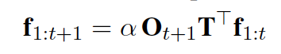
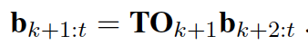
HMM: Forward-Backward
The forward equation
The backward equation

Slide 35
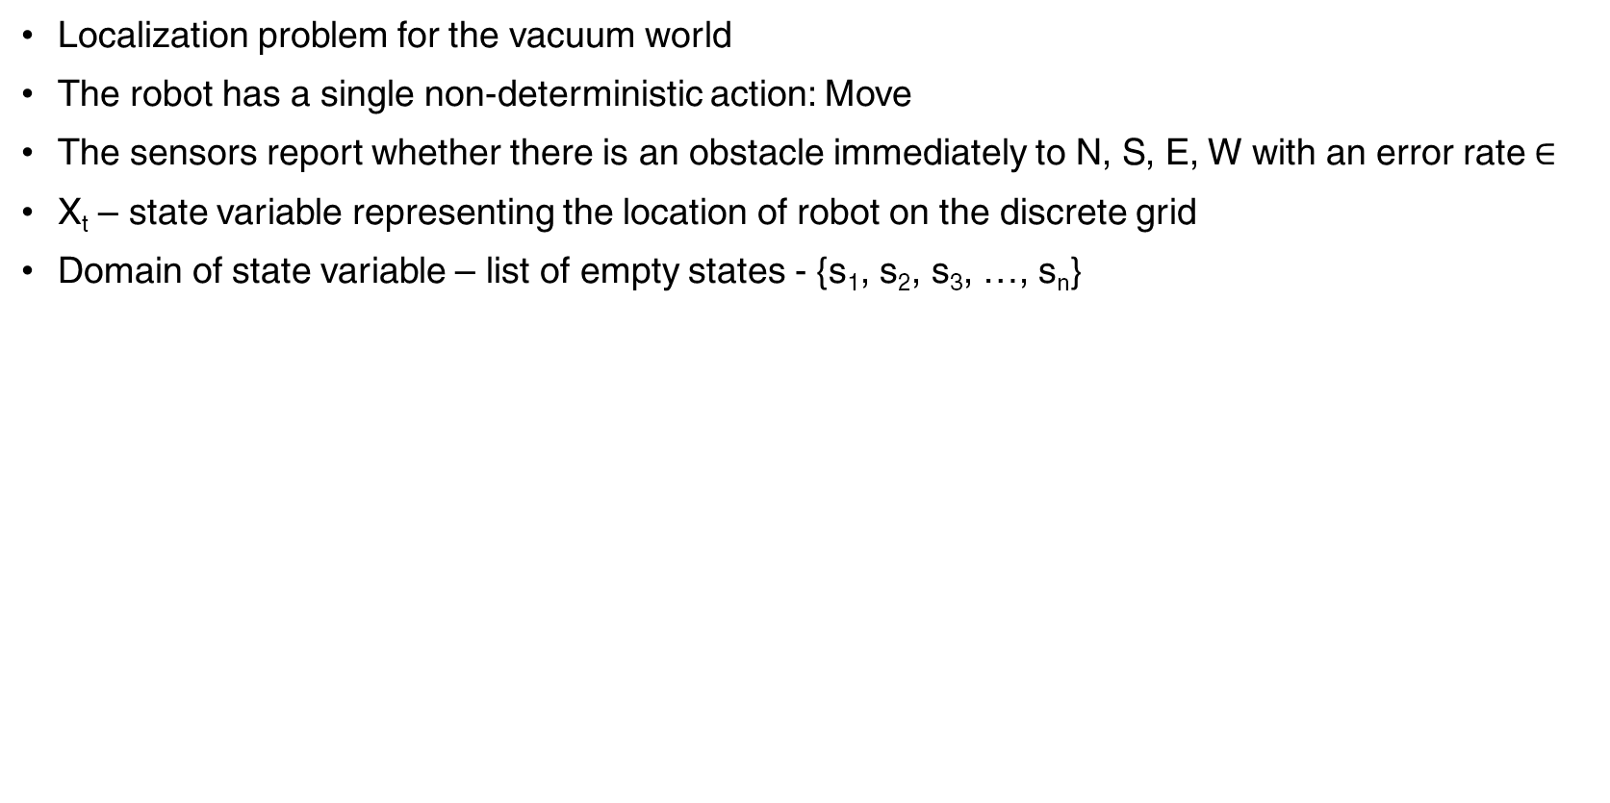
HMM Example: Localization
Localization problem for the vacuum world
The robot has a single non-deterministic action: Move
The sensors report whether there is an obstacle immediately to N, S, E, W with an error rate $∈$
X_{t} – state variable representing the location of robot on the discrete grid
Domain of state variable – list of empty states - {s₁, s₂, s₃, …, s_{n}}

Slide 36
HMM Example: Localization
NEIGHBORS(s) – set of empty squares that are adjacent to s
N(s) – set of that neighboring states
Transition model for Move – robot is equally likely to end up at any neighboring square
Initial state – uniform distribution over all squares
P(X₀ = i) = 1/n

Slide 37
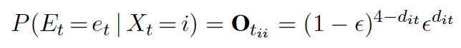
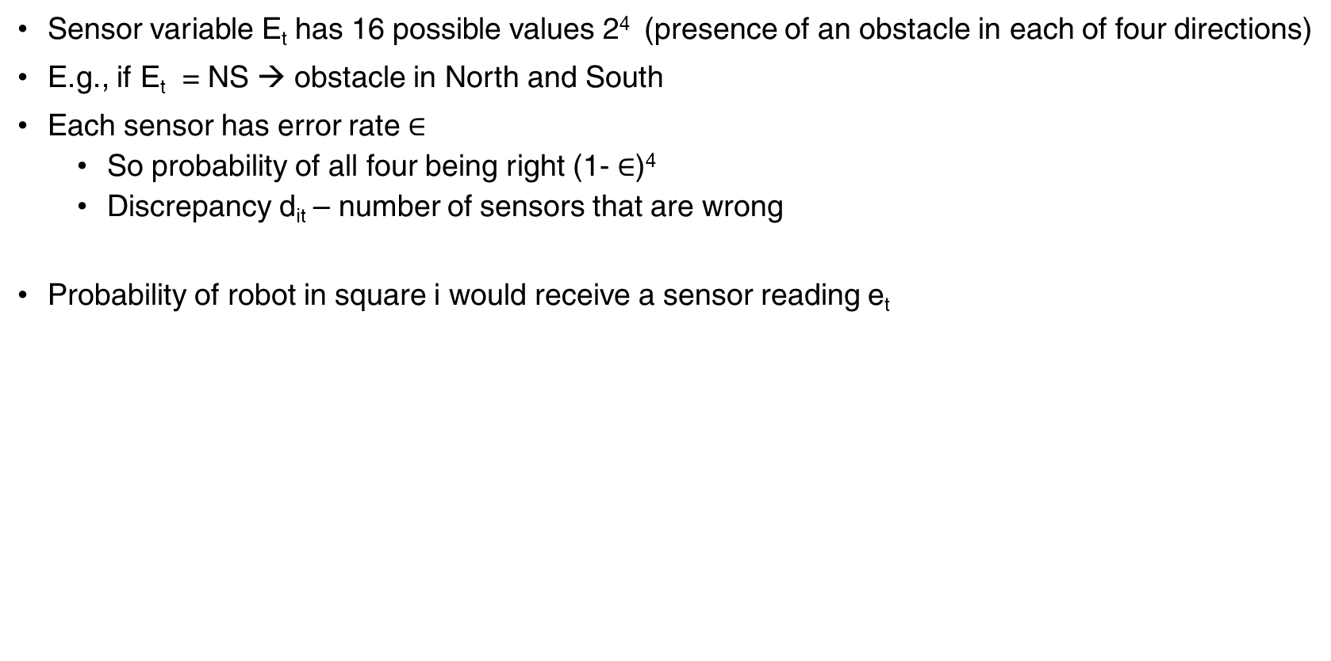
HMM Example - Localization
Sensor variable E_{t} has 16 possible values 2⁴ (presence of an obstacle in each of four directions)
E.g., if E_{t} = NS → obstacle in North and South
Each sensor has error rate $∈$
So probability of all four being right (1- $∈$)⁴
Discrepancy d_{it} – number of sensors that are wrong
Probability of robot in square i would receive a sensor reading e_{t}

Slide 38
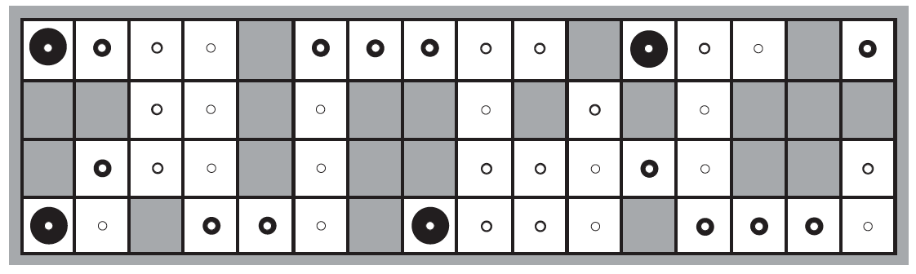
HMM Example - Localization
When E₁ = NSW, then P(X₁ | E₁ = NSW) is

Slide 39
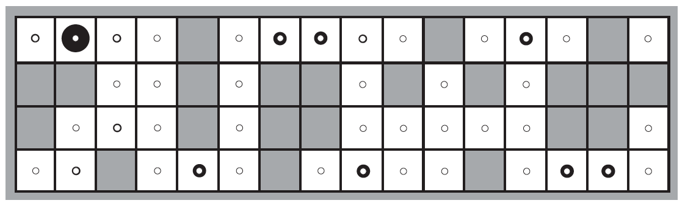
HMM Example - Localization
When E₂ = NS, then P(X₂ | E₁ = NSW, E₂ = NS) is

Slide 40
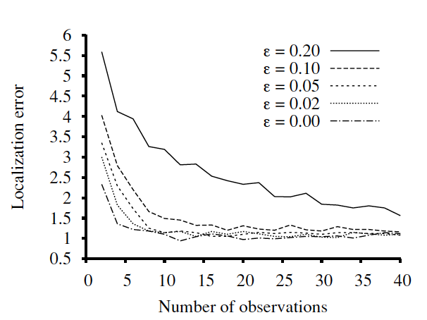
HMM Example - Localization

Slide 41
Thank You!
In our next session:
Supervised Learning

